Slide 1
SUPERVISED LEARNING
Intro. To ML

Slide 2
SUPERVISED LEARNING
A formalization of the idea of learning from examples
the learner (a computer program) is provided with two sets of data
Training and test sets
The idea is for the learner:
to “learn” from a set of labeled examples in the training set
so that it can identify unlabeled examples in the test set
with the highest possible accuracy.

Slide 3
SUPERVISED LEARNING
The goal of the learner is:
to develop a rule, a program, or a procedure that classifies new examples
(in the test set)
by analyzing examples it has been given that already have a class label.

Slide 4
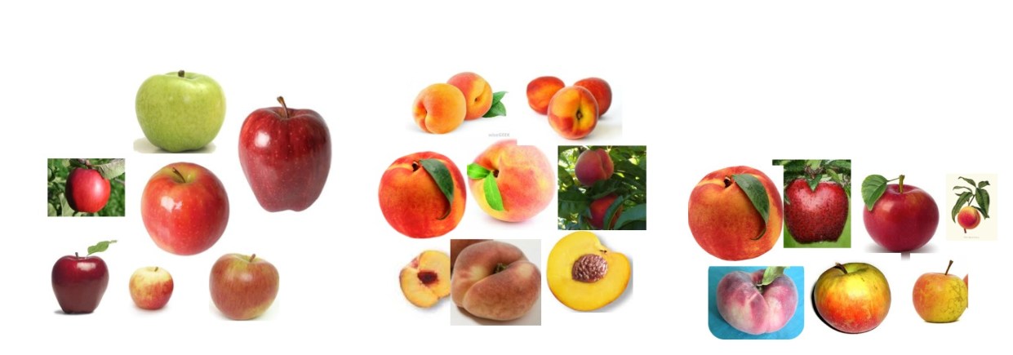
SUPERVISED LEARNING - EXAMPLE
A training set might consist of images of different types of fruit
peaches and nectarines
the identity of the fruit in each image is given to the learner
The test set would then consist of more unidentified pieces of fruit, but from the same classes.
GOAL?
to develop a rule that can identify the elements in the test set

Slide 5
SUPERVISED LEARNING - EXAMPLE
Training and test data for a fruit classifier.
LEFT: training data for the class of apples MIDDLE: training data for the peaches class
RIGHT: a mixture of fruit which could be used to test the classifier/model

Slide 6
SUPERVISED LEARNING
the training set consists of n ordered pairs (x1; y1), (x2; y2), …, (xn; yn)
Each x_{i} → some measurement or set of measurements of a single example data point
Y_{i} → the label for that data point
Example
an xi might be a group (sometimes called a vector) of five measurements for a patient in a hospital
height, weight, temperature, blood sugar level, and blood pressure
The corresponding yi might be a classification of the patient as healthy or not healthy

Slide 7
SUPERVISED LEARNING
The test data:
another set of m measurements without labels: (x_{n+1}; x_{n+2};… ; x_{n+m})
The goal
to make educated guesses about the labels for the test set (such healthy or not healthy) by drawing inferences from the training set.

Slide 8
WEKA
https://www.cs.waikato.ac.nz/ml/weka/
DATASETS
http://archive.ics.uci.edu/ml/index.php
https://storm.cis.fordham.edu/~gweiss/data-mining/datasets.html

